Slide 1
Working with 3rd parties and external APIs
SoftUni Team
Technical Trainers
Software University
https://softuni.bg

Slide 2
Table of Contents
What are 3rd parties?
External APIs
AWS (S3)
Payment provider (Wise)
Integration with the existing application
2

Slide 3
Have a Question?
sli.do
#Flask

Slide 4

What are 3rd parties

Slide 5
Definition
A third-party module is any code that has been written by a third party (neither you nor the python writers).
You can use them to add functionality to your code without having to write it yourself
Python comes with a package manager called pip. The name is a recursive acronym short for Pip Installs Packages
Virtualenv is a third-party tool for isolating Python package installations from each other.
If you are working on more than one project, it’s a good practice to keep their package requirements separate

Slide 6
Popular third-party libraries
requests
scrapy
Pillow
Django, Flask, Pyramid
SQLAlchemy
numpy, pandas
pytest, tox, coverage, mock
Jinija2
pylint, flake8, pep8
pymongo, redis, MySQL-Python, psycopg2

Slide 7

External APIs

Slide 8
Definition
An external or open API is an API designed for access by a larger population as well as web developers.
This implies that an external API can be easily used by developers inside the organization (that published the API) and any other developer from the outside who desires to register into the interface

Slide 9
Definition
We can integrate an existing API to our code, so that it provides extended functionality by reusing a part of the code form the provider
Payment modules in a given application often use third services such as Checkbook, Remitly, Paypal, Wise and many others

Slide 10
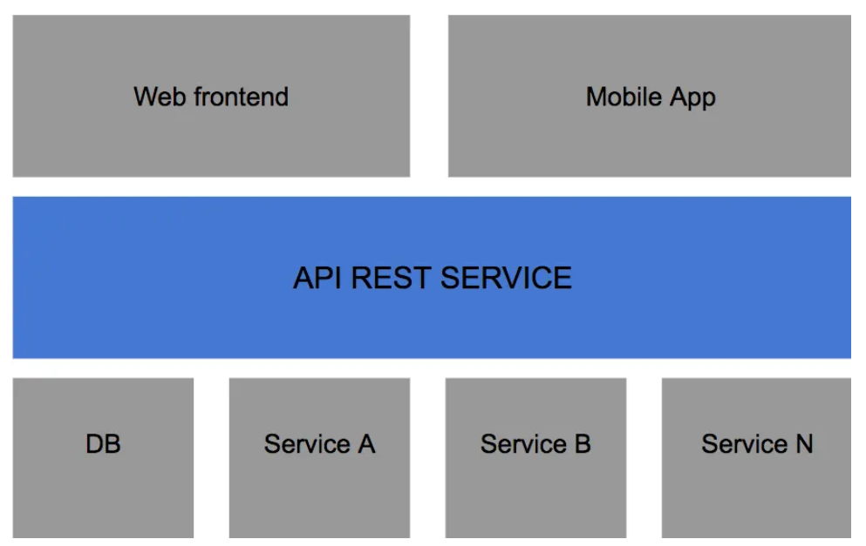
Example diagram

Slide 11

AWS

Slide 12
AWS
Amazon Web Services (AWS) is the world’s most comprehensive and broadly adopted cloud platform, offering over 200 fully featured services from data centers globally.
Millions of customers—including the fastest-growing startups, largest enterprises, and leading government agencies—are using AWS to lower costs, become more agile, and innovate faster.

Slide 13
Services
AWS is separated into different services;
each can be configured in different ways based on the user's needs.
Users should be able to see configuration options and individual server maps for an AWS service.

Slide 14
Services 2
Compute
Storage databases
Data management
Migration
Hybrid cloud
Networking
Development tools
Management
Monitoring
Security
Governance

Slide 15
Amazon Simple Storage Service (S3)
provides scalable object storage for data backup, collection and analytics.
An IT professional stores data and files as S3 objects -- which can range up to 5 gigabytes (GB) -- inside S3 buckets to keep them organized.
A business can save money with S3 through its Infrequent Access storage tier or by using Amazon Glacier for long-term cold storage.

Slide 16
BOTO 3
create, configure, and manage AWS services, such as Amazon Elastic Compute Cloud (Amazon EC2) and Amazon Simple Storage Service (Amazon S3).
The SDK provides an object-oriented API as well as low-level access to AWS services.
Docs can be found here

Slide 17
Usage in python
pip install boto3
import boto3
# Uses Amazon S3
s3 = boto3.resource('s3')
# Print out bucket names
for bucket in s3.buckets.all():
print(bucket.name)
# Upload a new file
data = open('test.jpg', 'rb')
s3.Bucket('my-bucket').put_object(Key='test.jpg', Body=data)

Slide 18
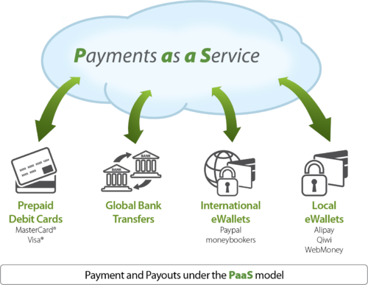
Payment provider

Slide 19
Definition
A payment service provider (PSP) is a third-party company that assists businesses to accept a wide range of online payment methods, such as online banking, credit cards, debit cards, e-wallets, cash cards, and more.
They ensure customer’s transactions make it from point A to point B, safely and securely.
Docs - here

Slide 20
Wise
Automate invoice payments, recurring transfers, standing orders, or payroll
Generate payments from invoicing software
Get real-time notifications on platforms like Slack
Add Wise as a disbursement option to your website
Simplify expense reporting
Track exchange rates and automate conversions

Slide 21
Usage in python
Pip install requests
import requests
url = "https=//api.sandbox.transferwise.tech/v1/accounts"
headers = {
"Authorization": "Bearer <your api token>",
"Content-Type": "application/json",
}
data = {
"currency": "GBP",
"type": "sort_code",
"profile": "your profile id",
"accountHolderName": "Ann Johnson",
"legalType": "PRIVATE",
"details": {"sortCode": "231470", "accountNumber": "28821822"},
}
resp = requests.post(url, headers=headers, data=data)

Slide 22

Live Demo

Slide 23
Questions?
Notes:
23

Slide 24












SoftUni Diamond Partners

Slide 25


Educational Partners

Slide 26
Trainings @ Software University (SoftUni)
Software University – High-Quality Education, Profession and Job for Software Developers
softuni.bg, softuni.org
Software University Foundation
softuni.foundation
Software University @ Facebook
facebook.com/SoftwareUniversity
Software University Forums
forum.softuni.bg
26
Notes:
26

Slide 27

License
This course (slides, examples, demos, exercises, homework, documents, videos and other assets) is copyrighted content
Unauthorized copy, reproduction or use is illegal
© SoftUni – https://softuni.org
© Software University – https://softuni.bg
Notes:
27

